Slide 1
Lecture 3: Data Abstraction
DS 4200
Spring 2023
Prof. Ab Mosca (they/them)
Northeastern University
Slides and inspiration from Cody Dunne, Michelle Borkin, Dylan Cashman, Krzysztof Gajos, Hanspeter Pfister,
Miriah Meyer, Jonathan Schwabish, and David Sprague, Ashley Suh

Slide 2
Last Class
We:
Reviewed Munzner’s Nested Model of Visualization Design
Finished ic-01, setting up Git
Any Questions?

Slide 3
Today
Visualization building blocks
Data Abstraction
HTML & CSS

Slide 4
Visualization Building Blocks
Notes:
Let’s start by talking about the building blocks of visualizations. In other words, what pieces of information do we need to build a visualization?

Slide 5

Visualization Building Blocks
Talk to your neighbors and brainstorm what you think the essential pieces for building a visualization are
Be prepared to share with the class
Notes:
I want to start by hearing your thoughts. Take a few minutes to brainstorm with your neighbors about what you think the essential pieces to a visualization are.

Slide 6
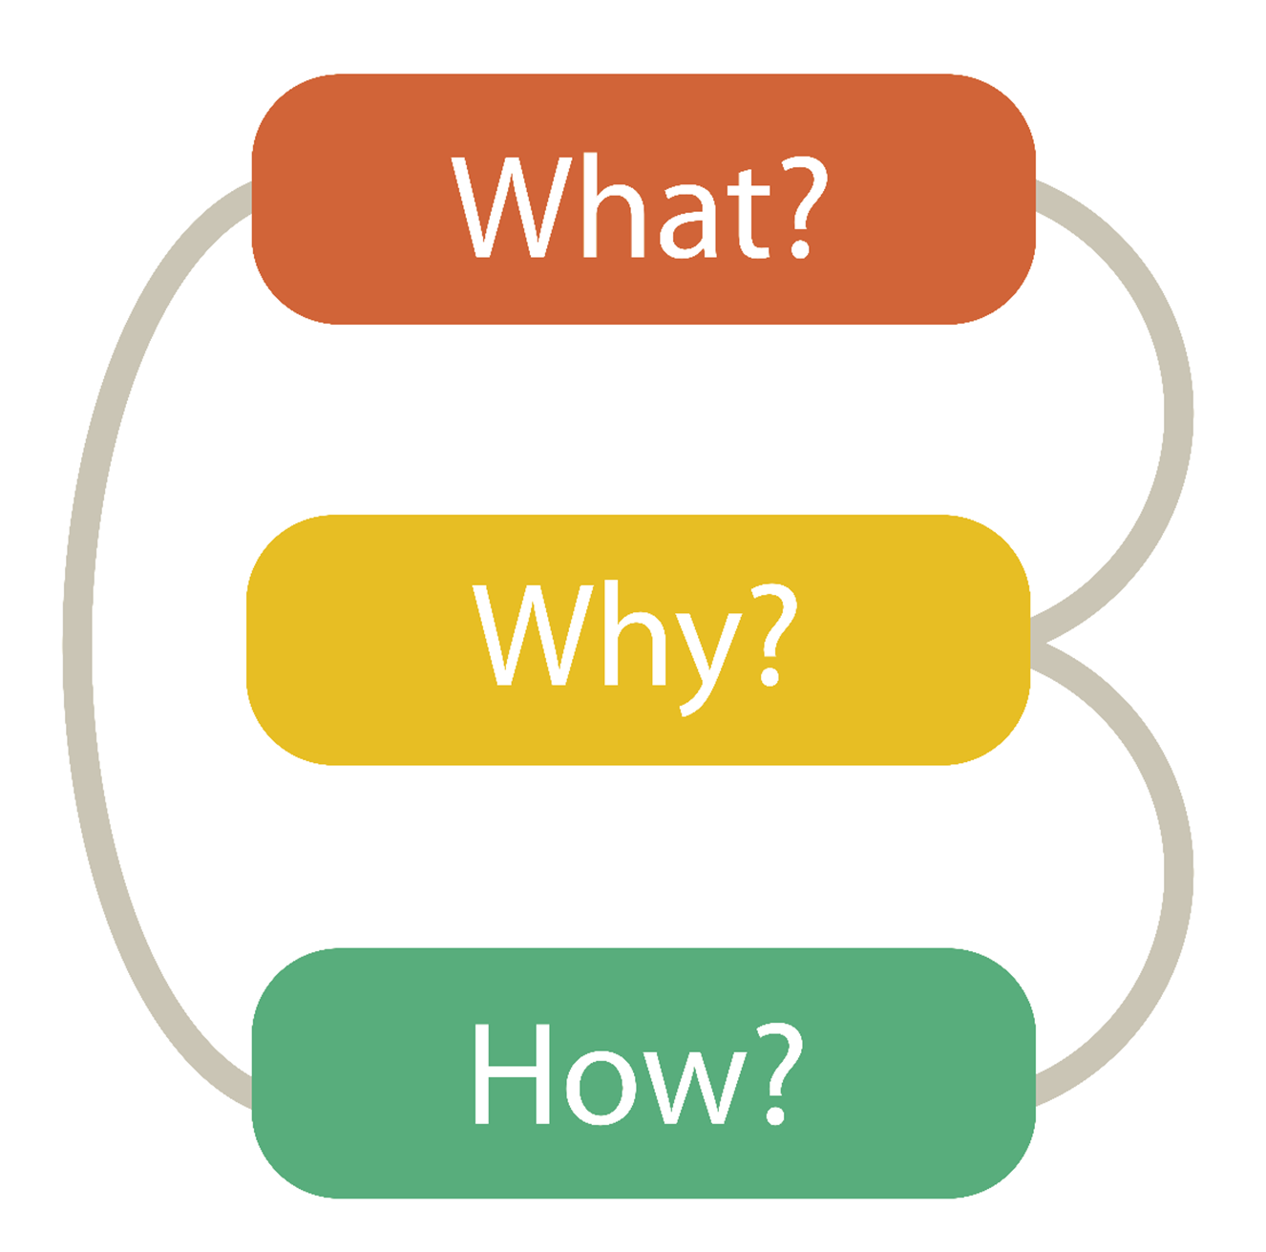
Visualization Building Blocks
What data is shown?
Why is the user analyzing / viewing it?
How is the data presented?
Notes:
Deciding what the visualization will show
Deciding why the visualization is necessary, or the purpose it will serve
And deciding How the visualization will present data.
A more formal way to refer to these steps are as <next>

Slide 7
Visualization Building Blocks
Data Abstraction
Task Abstraction
Visual Encoding
Notes:
Data abstraction, task abstraction, and visual encoding. <next>

Slide 8
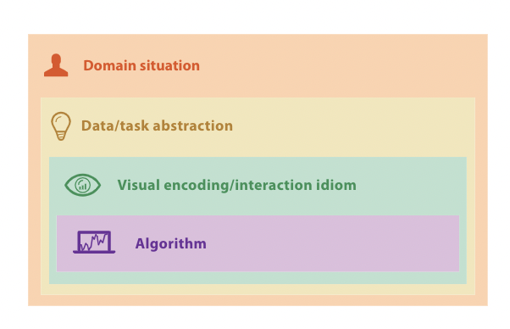

Visualization Building Blocks
Munzner’s Nested Model
Data Abstraction
Task Abstraction
Visual Encoding
Notes:
Data abstraction, task abstraction, and visual encoding. <next>

Slide 9

Visualization Building Blocks
Data Abstraction (what)
→ Source, biases, ethics, quality
→ Types, sets
Task Abstraction (why)
→ What does the user need to do?
→ What does the visualization need to do?
Visual Encodings (how)
→ How is data represented on the screen?
Notes:
Typically, when we think of the major building blocks of visualizations, these are the things we consider.
Data → What type or set of data are we working with? And also, where does the data come from? If it reliable, is it biased in any way?
Tasks → What are we building our visualization to facilitate? Should it help with specific analysis tasks? Should it tell a story? Is it meant to persuade?
Visual Encodings → This refers to how exactly data is represented on the screen. For example, are we using a bar chart, or a scatter plot?
We’re going to talk in depth about each of these building blocks throughout this class.

Slide 10
Visualization Building Blocks
Data Abstraction
Task Abstraction
Visual Encoding
Notes:
Data abstraction, task abstraction, and visual encoding. <next>

Slide 11
Data Abstraction
From Munzner’s book
Notes:
Today, we’ll start with data. Specifically types and sets.

Slide 12
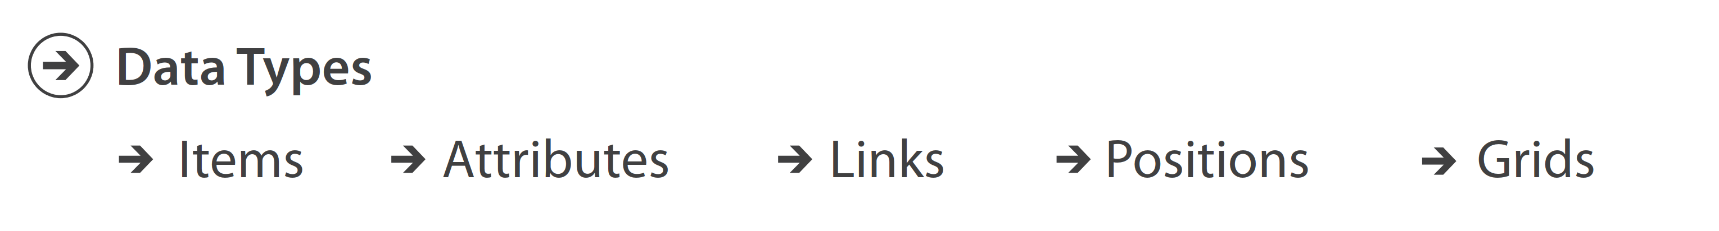
Data Types
Data Type = structural or mathematical interpretation of the data
Notes:
In the world of visualization, we define a data type as …
And given this definition, there are certain categories, or types, that we organize data into.
Let’s define each of these.

Slide 13


Data Types
Data Type: Items
An individual entity that is discrete
Ex. Row in table, node in network

Slide 14
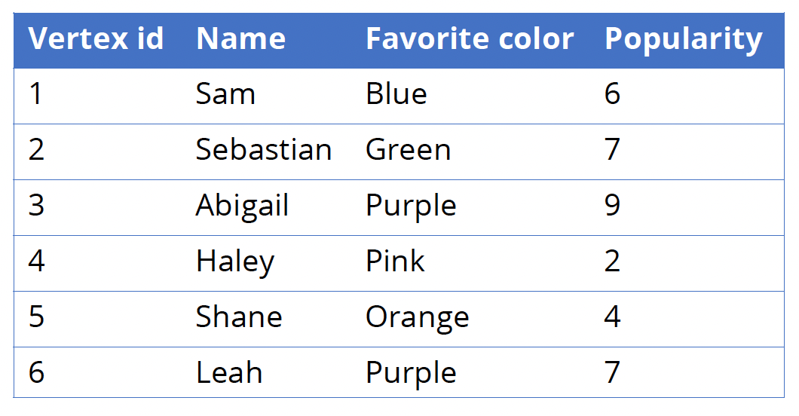
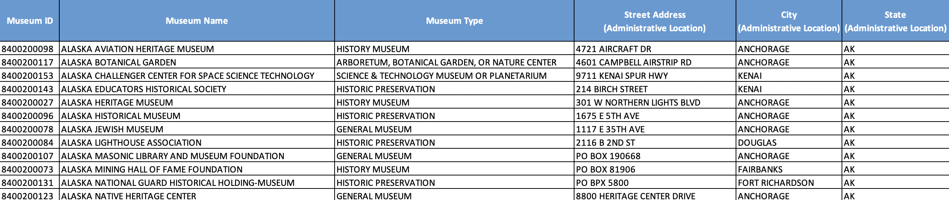
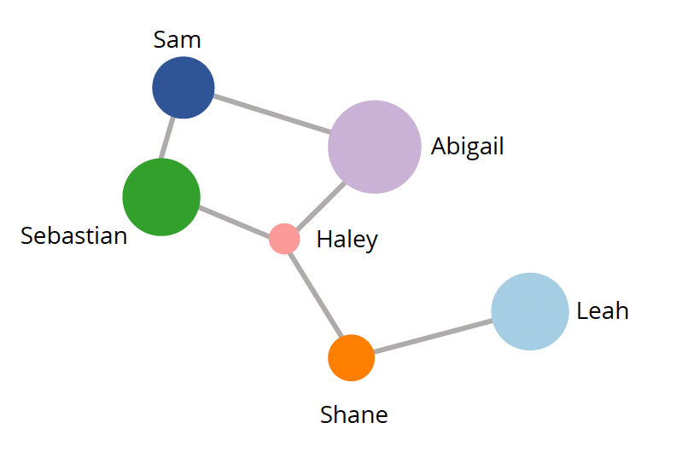
Data Types
Data Type: Items
An individual entity that is discrete
Ex. Row in table, node in network
https://www.kaggle.com/imls/museum-directory

Slide 15



Data Types
Data Type: Attributes
Specific property that can be measured, observed, or logged
Ex. Salary, temperature, protein expression levels
Notes:
Typically what we call the columns in a tabular dataset.

Slide 16
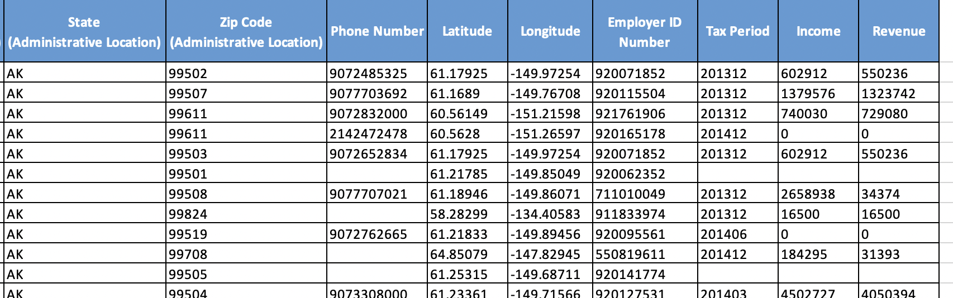
Data Types
Data Type: Attributes
Specific property that can be measured, observed, or logged
Ex. Salary, temperature, protein expression levels
https://www.kaggle.com/imls/museum-directory
Notes:
Typically what we call the columns in a tabular dataset.

Slide 17
Data Types
Data Type: Link
Relationship between two items
Ex. Edge in a network
Notes:
Other example could be a bounding box of specific items

Slide 18
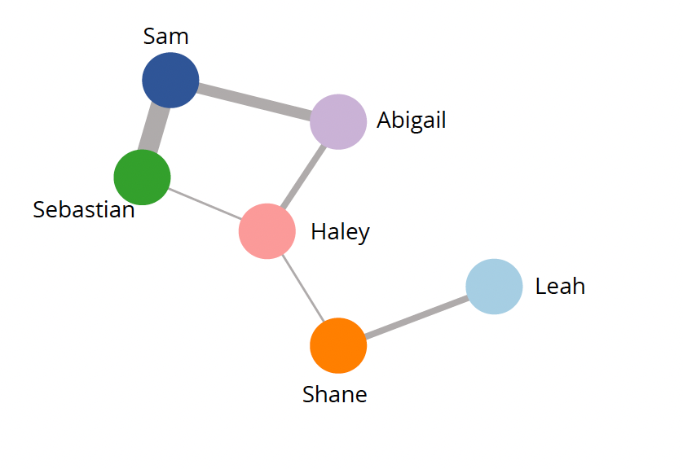
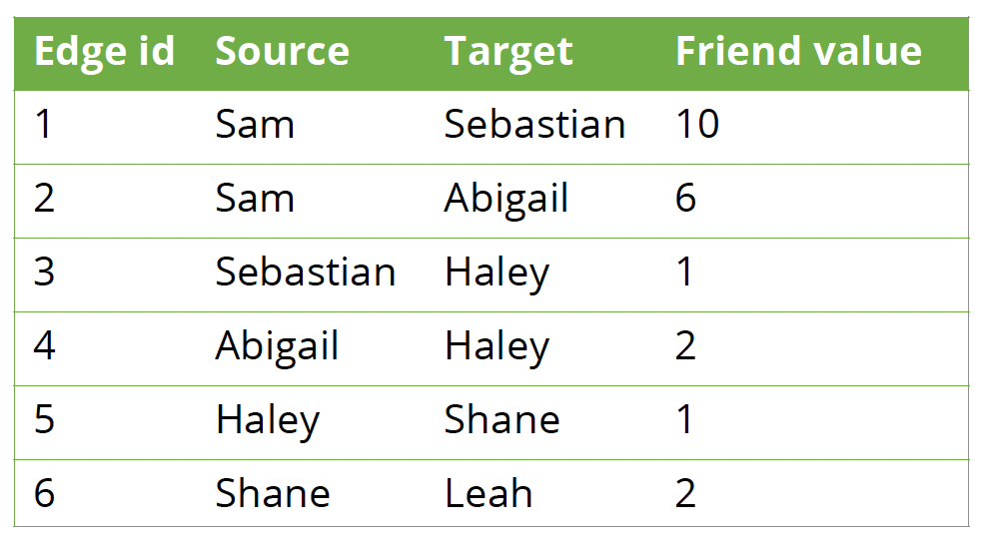
Data Types
Data Type: Link
Relationship between two items
Ex. Edge in a network
Notes:
Like items, links can have attributes associated with them

Slide 19

Data Types
Data Type: Position
Spatial data providing a location in 2D or 3D
Ex. Latitude & longitude, three numbers describing a region in space measured by a medical scanner
(x, y, z)
42.3398° N, 71.0892° W
Borkin 2010

Slide 20
Data Types
Data Type: Position
Spatial data providing a location in 2D or 3D
Ex. Latitude & longitude, three numbers describing a region in space measured by a medical scanner
https://www.kaggle.com/imls/museum-directory

Slide 21
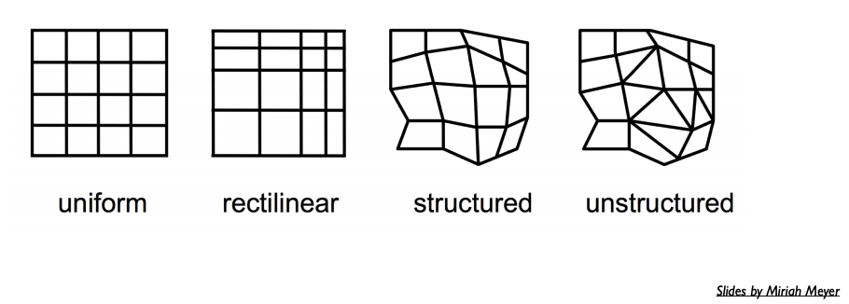
Data Types
Data Type: Grid
Specifies the strategy for sampling continuous data in terms of geometric and topological relationships between cells
Notes:
Ex. Visualizing airflow over airplane wings, I would specifically choose to sample data points spatially located around the wings.
Ex. Visualizing wind patterns to help decide where to build turbines, I’d probably look at a uniform sample across the space I’m considering.

Slide 22
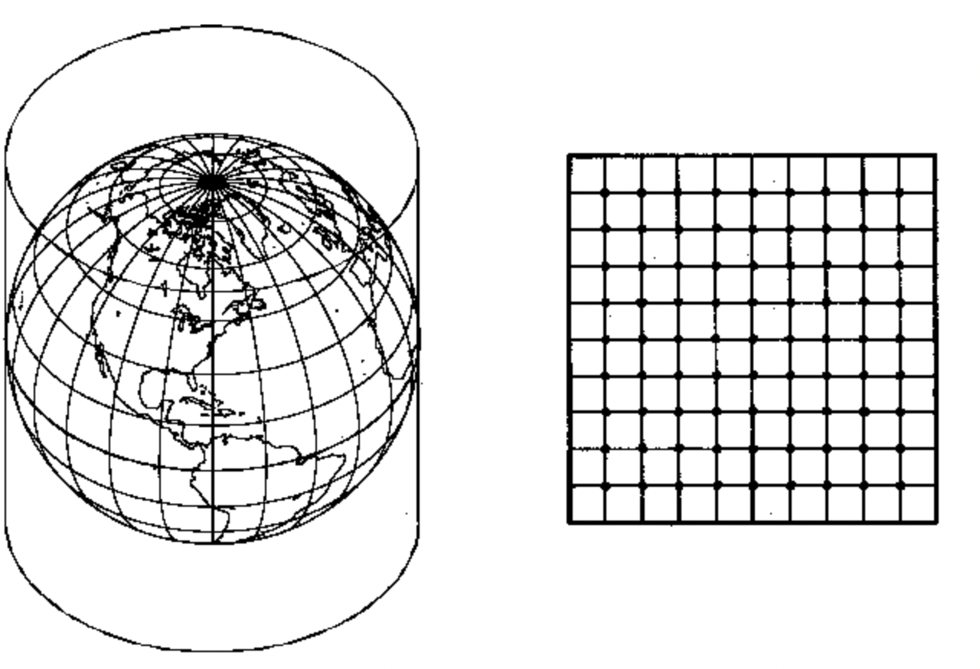
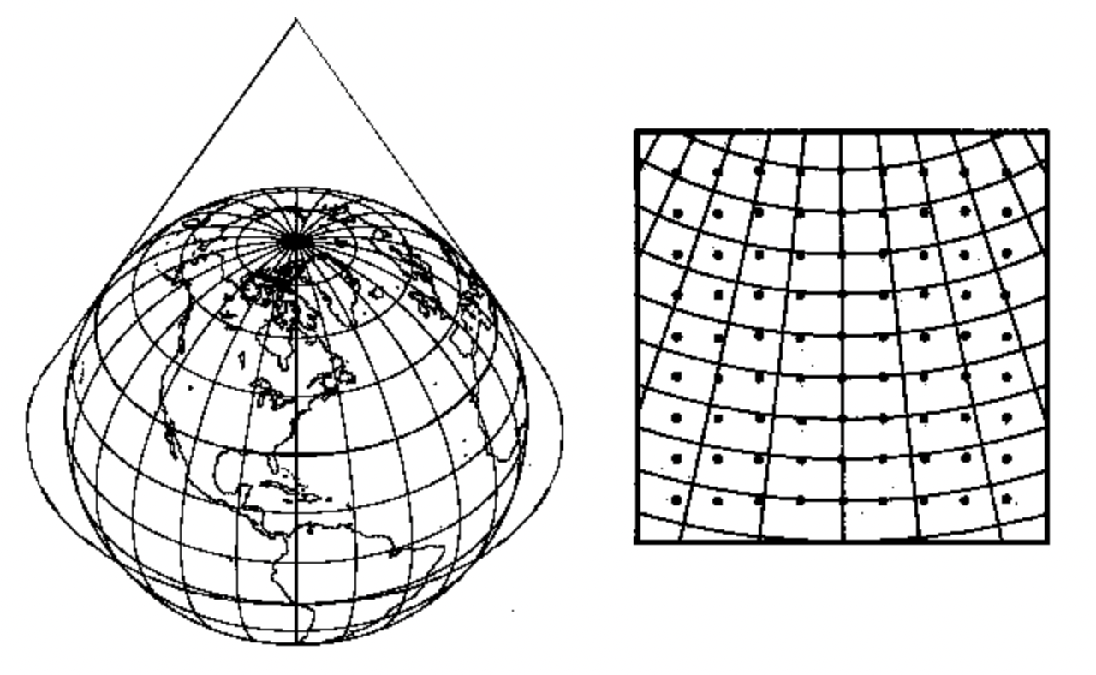

Data Types
Data Type: Grid
Specifies the strategy for sampling continuous data in terms of geometric and topological relationships between cells
https://www.ssec.wisc.edu/mcidas/doc/prog_man/2003/access-3.html
Notes:
Different grids formed by projecting the globe to a flat map.
Ex. Visualizing airflow over airplane wings, I would specifically choose to sample data points spatially located around the wings.
Ex. Visualizing wind patterns to help decide where to build turbines, I’d probably look at a uniform sample across the space I’m considering.

Slide 23
Datasets
Dataset = collection of information that is the target of analysis
Notes:
Now we just looked at specific data types, however our data usually comes in collections, or datasets.
Formally, in visualization, we define datasets as …
Similar to data, there are different types of datasets. Next

Slide 24
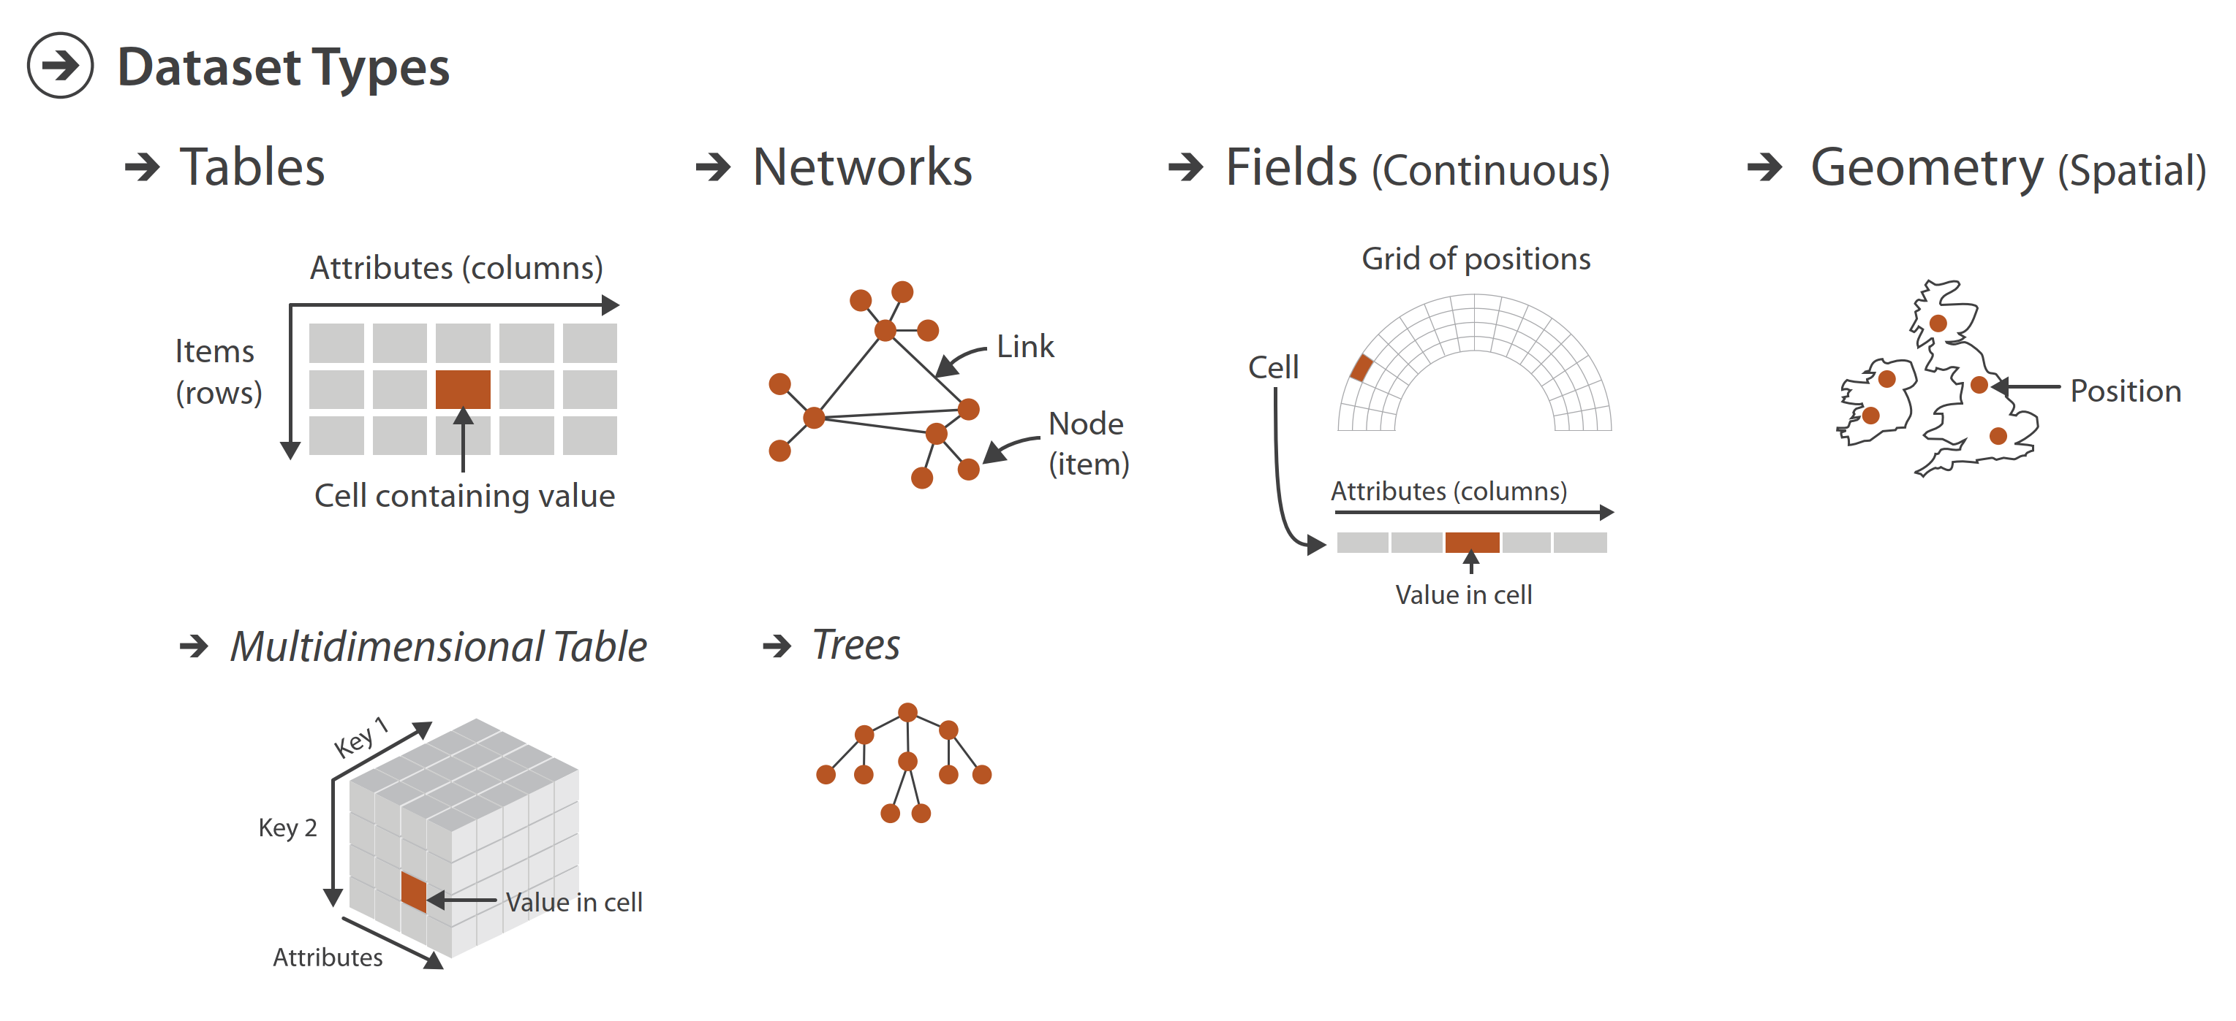
Dataset Types
Dataset = collection of information that is the target of analysis
Dataset type is determined by the types of data making up the set
Notes:
We determine a dataset’s type by looking at the types of data it contains

Slide 25
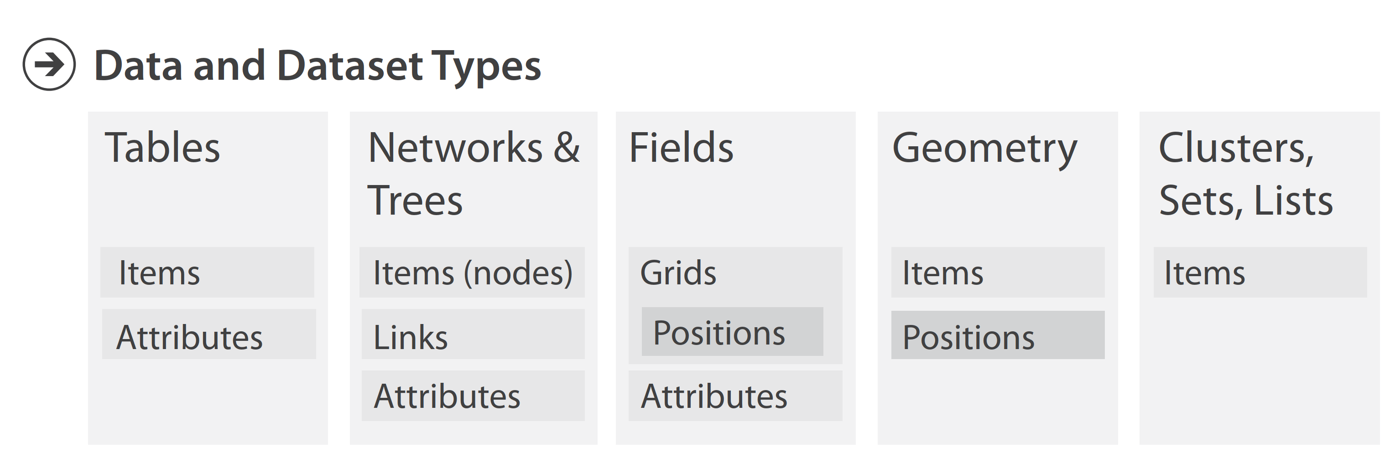
Data & Dataset Types
Dataset = collection of information that is the target of analysis
Dataset type is determined by the types of data making up the set
Notes:
Internal structure of dataset types
So, to lay this out a little more clearly, we define tables as … etc.

Slide 26
Data & Dataset Types
Dataset = collection of information that is the target of analysis
Dataset type is determined by the types of data making up the set
Notes:
One thing I want to zoom in on a little more are attributes, which show up in a lot of contexts.
You also probably noticed that attributes are a huge category of data. Because of this, we actually break them down into different types as well.

Slide 27
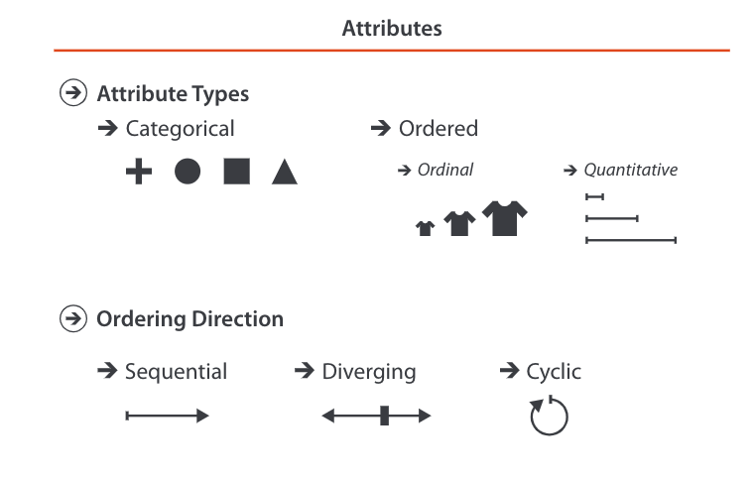
Attributes
Attribute = Specific property that can be measured, observed, or logged
There are different types of attributes
(i.e. continuous)
Ex.
Fruit: apple, pear, grape
Colleges: CAMD, Khoury, COE
Ex.
Sizes: s, m, l
Months: Jan., Feb.
Ex.
Lengths: 1’, 2.5’, 5’
Population: 1m., 11.75 m., 2.2 m.
Notes:
Remember, and attribute is …
Now, that’s a very broad definition, and we can actually break attributes into more granular categories.
Those categories are either categorical, or ordered. And within ordered attributes we can think about ordered categories (ordinal), or quantitative (continuous) values

Slide 28
Attributes
Attribute = Specific property that can be measured, observed, or logged
There are different types of attributes
(i.e. continuous)
Ex.
Fruit: apple, pear, grape
Colleges: CAMD, Khoury, COE
Ex.
Sizes: s, m, l
Months: Jan., Feb.
Ex.
Lengths: 1’, 2.5’, 5’
Population: 1m., 11.75 m., 2.2 m.
Notes:
There’s specific vocabulary we use when we talk about Categorical and ordinal attributes

Slide 29
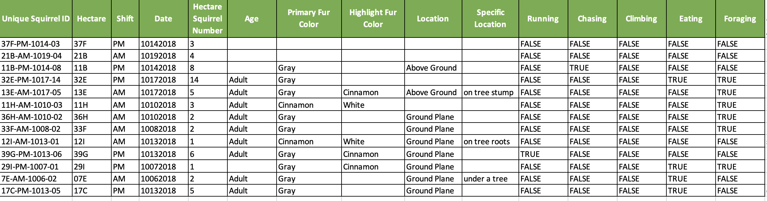
Attributes
Attribute = Specific property that can be measured, observed, or logged
levels are the different groups in categorical and ordinal attributes
AM,
PM
Adult,
Juvenile
Gray,
Cinnamon
Cinnamon,
White
Above Ground,
Ground Plane
https://data.cityofnewyork.us/Environment/2018-Squirrel-Census-Fur-Color-Map/fak5-wcft
Notes:
There’s specific vocabulary we use when we talk about Categorical and ordinal attributes

Slide 30
Attributes
Attribute = Specific property that can be measured, observed, or logged
There are different types of attributes
(i.e. continuous)
Ex.
Fruit: apple, pear, grape
Colleges: CAMD, Khoury, COE
Ex.
Sizes: s, m, l
Months: Jan., Feb.
Ex.
Lengths: 1’, 2.5’, 5’
Population: 1m., 11.75 m., 2.2 m.
Notes:
When we talk about ordered attributes, there are different kinds of ordering to consider.

Slide 31
Attributes
Attribute = Specific property that can be measured, observed, or logged
There are types of orderings for ordered attributes
Ex.
Height: > 0
Counts
Ex.
Elevation: below sea level, at sea level, above sea level
Temperature
Ex.
Time: hour of day
Moon Phases
Notes:
Read

Slide 32
Visualization Building Blocks
Form a group of three
Come up with an example of data that fits the attribute type you are assigned
Add your example to the attribute-types spreadsheet
Notes:
Do by rows and area in classroom
Categorical
Ordered --> Ordinal --> Sequential
Ordered --> Ordinal --> Divergent
Ordered --> Ordinal --> Cyclic
Ordered --> Quantitative --> Sequential
Ordered --> Quantitative --> Divergent
Ordered --> Quantitative --> Cyclic

Slide 33
Let’s take a break! Stretch, go for a walk, be social ☺ Be back here in 10 mins.

Slide 34
Intro to HTML + CSS

Slide 35
HTML
HTML
→ Hypertext Markup Language
→ A markup language that defines the structure of webpages
https://www.w3schools.com/html/html_intro.asp
Notes:
HTML stands for hypertext markup language
Essentially what it is is a markup language that defined the structure of webpages.
How this works is you write a webpage using HTML, and when you open that file using a web browser, the browser parses the HTML and translates it into different elements of a webpage.

Slide 36
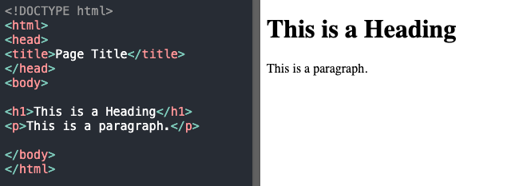
HTML
HTML
→ We edit .html files (i.e. create webpages) using a text editor (ex. Sublime)
→ Browsers (ex. Chrome) parse .html files into webpages
index.html opened with sublime
index.html opened with chrome
https://www.w3schools.com/html/html_intro.asp
Notes:
HTML stands for hypertext markup language
Essentially what it is is a markup language that defined the structure of webpages.
How this works is you write a webpage using HTML, and when you open that file using a web browser, the browser parses the HTML and translates it into different elements of a webpage.

Slide 37
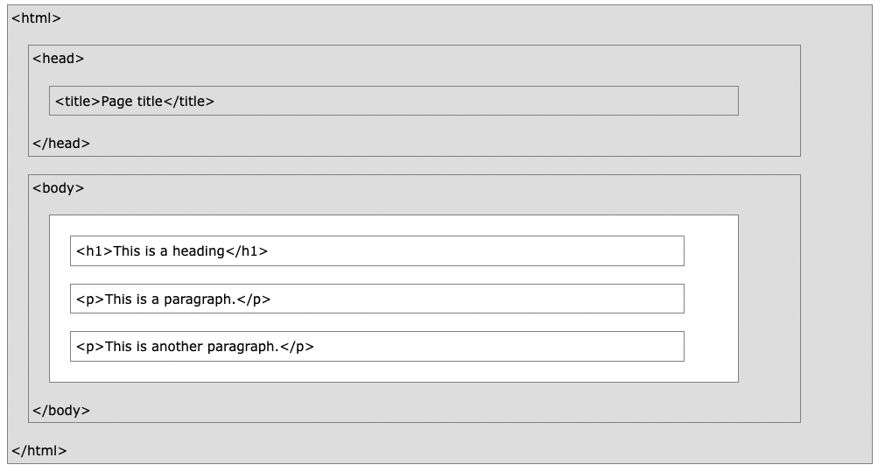
HTML
HTML
→ Defines webpage structure as a series of elements identified by tags and
filled with content
https://www.w3schools.com/html/html_intro.asp
Notes:
These elements are identified by tags and are filled with content.

Slide 38
HTML
HTML
→ We conceptualize the structure of webpages using the Document Object Model (DOM)
Document
Head
Body
Title
Heading 1
Paragraph
https://www.w3schools.com/html/html_intro.asp
Notes:
We conceptualize the structure of webpages using something called the Document Object Model, or DOM.
This model conceptualizes a webpage a a tree, where the document is the root, and tags nested within other tags in your html are considered children.

Slide 39
Class Demo
Slides after this point are for you to have as reference later
Notes:
We conceptualize the structure of webpages using something called the Document Object Model, or DOM.
This model conceptualizes a webpage a a tree, where the document is the root, and tags nested within other tags in your html are considered children.

Slide 40
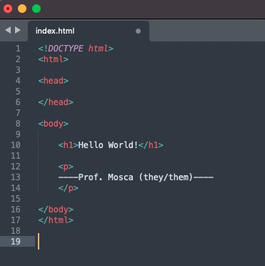
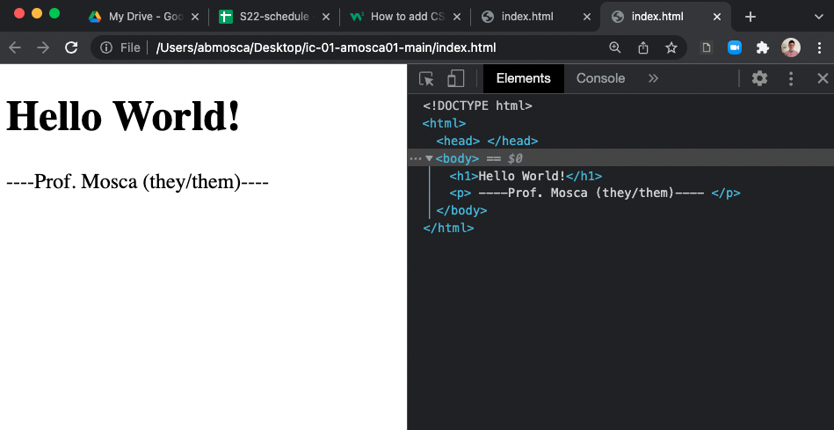
HTML
HTML
→ You can view the HTML for any webpage using the developer console
Notes:
You can view the html for any webpage using the developer console for your browser.
For example here you can see my html file, how it renders in the browser, and a copy of the html that I can look at in my developer console in my browser.

Slide 41
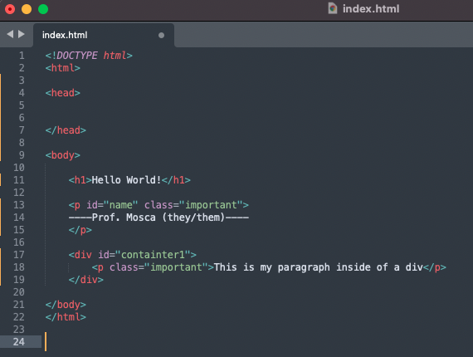
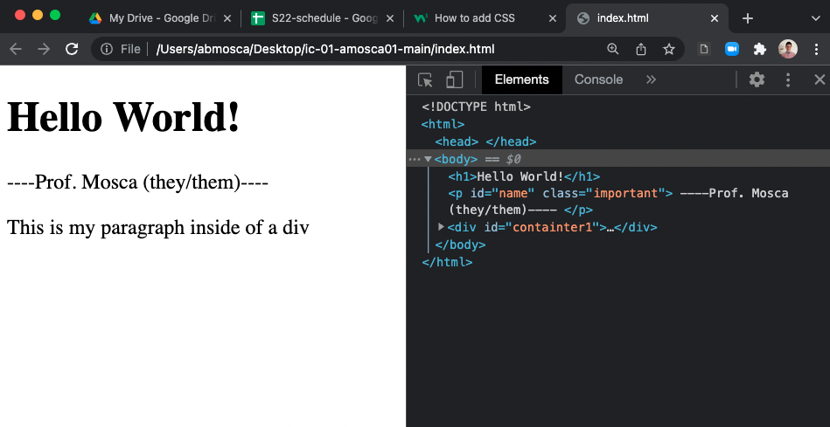
HTML
HTML
→ Distinguish between elements with id’s and group them with classes
Notes:
We can add data to any of our webpage elements in our html. For example, to distinguish between elements we can give them id’s (which are unique) and classes (which are not unique).
You can see if I add these to my html file my webpage looks the same, but if I check the developer console I can see the same classes and id’s I added show up here.

Slide 42
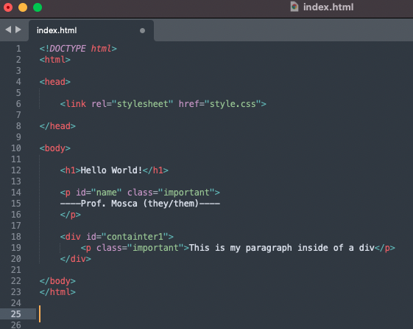
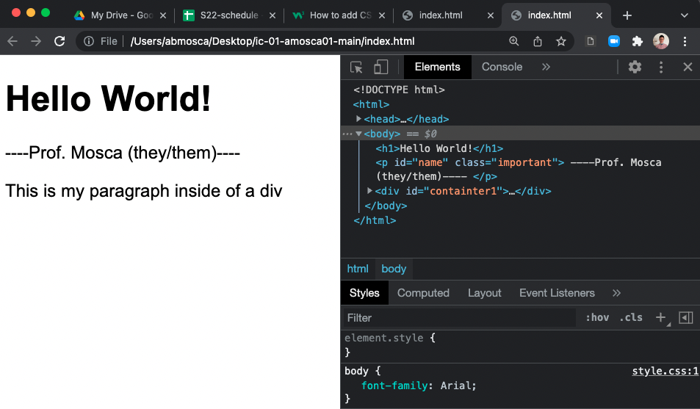
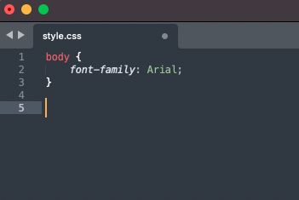
HTML + CSS
CSS
→ Cascading Style Sheet
→ Used to style HTML elements
Notes:
While HTML defines the structure of a webpage, CSS defines they style.
CSS stands for …
In this class we will use external style sheets. That means we include the stylesheet in the head of our html file, and then have a separate .css file in which we code styling.
In this example I made all of the font in the body of my webpage Arial.
You can see this in the browser, and in the developer console notice that I can see my HTML and if I select <body> I can see the style applied to it at the bottom of the console.

Slide 43
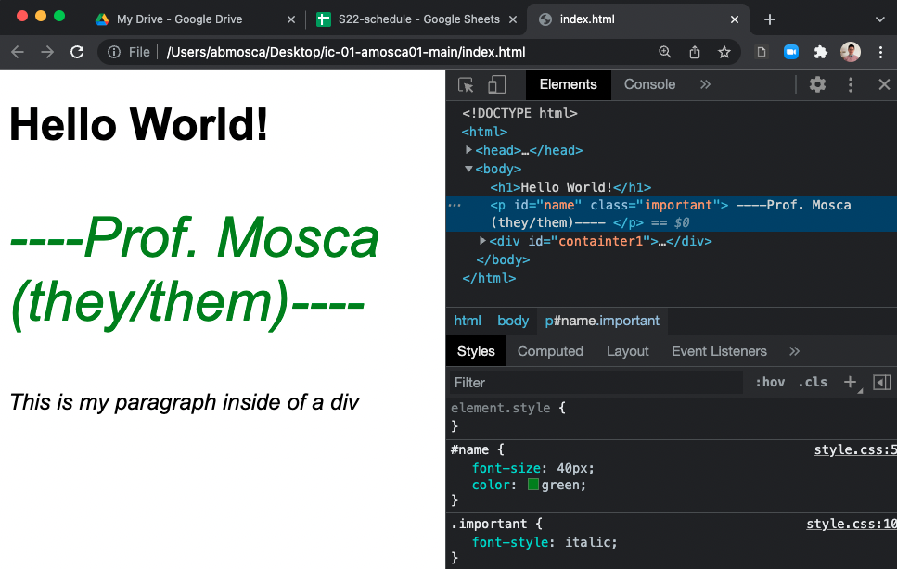
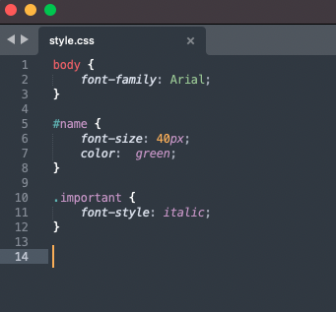
HTML + CSS
CSS
→ Apply style to elements, id’s, or classes
Notes:
We can use the ids and classes we added to our html elements to add styling to select elements.
For example, in my css file I can say for anything with the id name, make the font in this element bigger and make it green.
You can see this shows up in my rendered webpage to the right. My name (which is inside of the paragraph tag with id = name) is not big and gree.
We can also apply styling for specific classes. In my css I styled anything with the class “important” as italic font. You can see in my rendered webpage that made my name and the other paragraph on the page render with italic font.
And again if I click on an element in the developer console I can see the different styles that are applied.

Slide 44
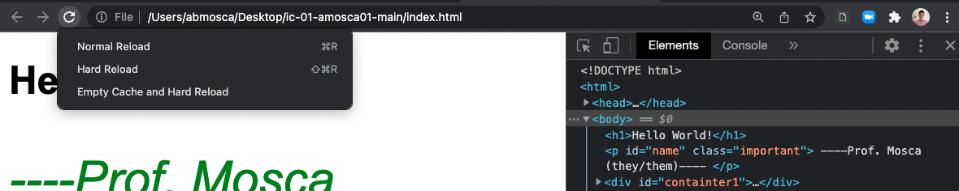
HTML + CSS
General Tips
→ W3Schools is a great resource. Note all of the topics linked on the left-hand side of the page.
→ If you update your HTML/CSS and see no changes in the browser, try clearing your cache.
With the developer console open, right click on the refresh button
Notes:
To sum it all up, here are some general tips for HTML and CSS.
W3Schools, which is linked in ic-04 is a great resource for looking up syntax of tags and css styling. I highly recommend using it.
If at any point you change your html and your webpage is not updating, try clearing your cache.

Slide 45
ic-02: HTML, CSS

Slide 46
Summary
Today we:
Reviewed building blocks of visualization
Reviewed data abstraction
Intro’d HTML and CSS
ic-02 is DUE today.

